Slide 1
MODULE 4 COMPUTER FORENSICS
Analysis and Validation:-

Slide 2
Determining What Data to Collect and Analyze
Examining and analyzing digital evidence depend on the nature of the investigation and the amount of data to process.
Criminal investigations are limited to finding data defined in the search warrant, and civil investigations are often limited by court orders for discovery.
Corporate investigators might be searching for company policy violations that require examining only specific items, such as e-mail.
These types of investigations can also result in scope creep, in which an investigation expands beyond the original description because of unexpected evidence you find, prompting the attorney to ask you to examine other areas to recover more evidence.
Scope creep increases the time and resources needed to extract, analyze, and present evidence.

Slide 3
Approaching Computer Forensics Cases
Inventory the hardware on the suspect’s computer and note the condition of the computer when seized. For static acquisitions, remove the original drive from the computer, if practical, and then check the date and time values in the system’s CMOS.
Record how you acquired data from the suspect drive—note, for example, that you created a bit-stream image and which tool you used.
List all folders and files on the image or drive.
For all password-protected files that might be related to the investigation, make your best effort to recover file contents. You can use password recovery tools for this purpose.
Identify the function of every executable (binary or .exe) file that doesn’t match known hash values. Make note of any system files or folders, such as the System32 folder or its content, that are out of place.
Notes:
For target drives, use only recently wiped media that have been reformatted and inspected for computer viruses
Inventory the hardware on the suspect’s computer and note the condition of the computer when seized. Document all physical hardware components as part of your evidence acquisition process.
For static acquisitions, remove the original drive from the computer, if practical, and then check the date and time values in the system’s CMOS.
Record how you acquired data from the suspect drive—note, for example, that you created a bit-stream image and which tool you used. The tool you use should also create an MD5 or SHA-1 or better hash for validating the image.
When examining the image of the drive’s contents, process the data methodically and logically.
List all folders and files on the image or drive.If possible, examine the contents of all data files in all folders, starting at the root directory of the volume partition.
For all password-protected files that might be related to the investigation, make your best effort to recover file contents. You can use password recovery tools for this purpose.
Identify the function of every executable (binary or .exe) file that doesn’t match known hash values. Make note of any system files or folders, such as the System32 folder or its content, that are out of place.
Maintain control of all evidence and findings, and document everything as you progress through your examination.

Slide 4
Using AccessData Forensic Toolkit to Analyze Data (using FTK)
With FTK, you can store everything from image files to recovered server folders on one investigation drive.
FTK has two options for searching for keywords.
One option is an indexed search, which catalogs all words on the evidence drive so that FTK can find them quickly. This option returns search results quickly, although it does have some shortcomings.
The other option is a live search, which can locate items such as text hidden in unallocated space that might not turn up in an indexed search.
During data processing, FTK also opens compressed files, including Microsoft cabinet (.cab) files, Microsoft personal e-mail folders (.pst or .ost), and .zip files. FTK indexes any compressed files it can open.
To generate reports with the FTK Report Wizard, first you need to bookmark files during an examination.

Slide 5
Validating Forensic Data
Most computer forensic tools—such as ProDiscover, X-Ways Forensics, FTK, and EnCase— provide automated hashing of image files
Validating with Hexadecimal Editors
Hex editors are often used to crack copy-protected software, study how computer viruses work, or in the case of forensics, identify and retrieve information that can't normally be accessed by the operating system.
Advanced hexadecimal editors offer many features not available in computer forensics tools, such as hashing specific files or sectors.
Getting a hash value with a full-featured hexadecimal editor is much faster and easier than with a computer forensics tool.
Notes:
When software is copy-protected, it is designed to prevent users from making unauthorized copies of the software. However, hackers may use hex editors to crack the copy protection by modifying the software's code. By examining the binary code using a hex editor, a hacker can identify the code that is responsible for the copy protection and modify it to disable or bypass the protection

Slide 6
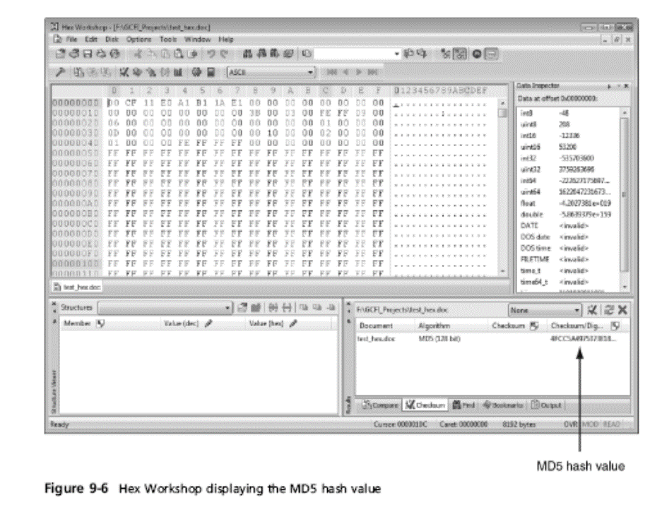

Slide 7
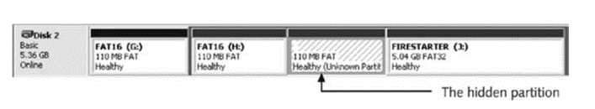
Addressing Data-Hiding Techniques
One way to hide partitions is to create a partition and then use a disk editor, such as Norton DiskEdit, to delete any reference to it manually.
To access the deleted partition, users can edit the partition table to re-create the links, and then the hidden partition reappears when the computer is restarted.
Another way to hide partitions is with a disk-partitioning utility, such as GDisk, Partition Magic, System Commander

Slide 8
Marking Bad Clusters
Another data-hiding technique, more common in FAT file systems, is placing sensitive or incriminating data in free or slack space on disk partition clusters.
This technique involves using a disk editor, such as Norton DiskEdit, to mark good clusters as bad clusters.
The OS then considers these clusters unusable. The only way they can be accessed from the OS is by changing them to good clusters with a disk editor.
To mark a good cluster as bad in Norton DiskEdit, you type the letter B in the FAT entry corresponding to that cluster.
You can then use any DOS disk editor to write and read data to this cluster, which is effectively hidden because it appears as bad to the OS.

Slide 9
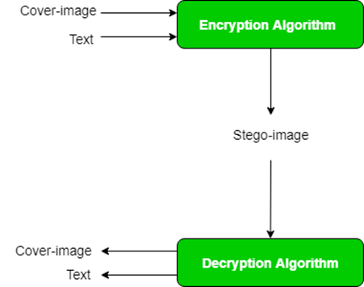
Using Steganography to Hide Data
The term steganography comes from the Greek word for “hidden writing.” It’s defined as hiding messages in such a way that only the intended recipient knows the message is there.
Many steganography tools were created to protect copyrighted material by inserting digital watermarks into a file. Some digital watermarks are designed to be visible—for example, to notify users that an image is copyrighted.
The digital watermarks used for steganography aren’t usually visible

Slide 10
To help identify steganography files, use the following list as a guideline:
1. Locate the last modified date by checking the steganography tool’s timestamp.
2. Look for files that appear as both a .bmp and a .jpg file, which might indicate files that started out in one format and then were modified and saved in another format.
3. Generate a list of all files with a date and time equal to or after the last modified date of the steganography tool, and then examine each file in the generated listing.

Slide 11
Examining Encrypted Files
People who want to hide data can also use advanced encryption programs, such as PGP or BestCrypt.
Encrypted files are encoded to prevent unauthorized access. To decode an encrypted file, users supply a password or passphrase.
Many commercial encryption programs use a technology called key escrow, which is designed to recover encrypted data

Slide 12
Recognizing a Graphics File
You might have used a graphics program, such as Microsoft Paint, Adobe Photoshop, or Gnome GIMP, to create or edit an image.
A graphics program creates one of three types of graphics files: bitmap, vector, and metafile.
Bitmap images are collections of dots, or pixels, in a grid format that form a graphic.
Vector graphics are based on mathematical instructions that define lines, curves, text, ovals, and other geometric shapes.
Metafile graphics are combinations of bitmap and vector images.

Slide 13

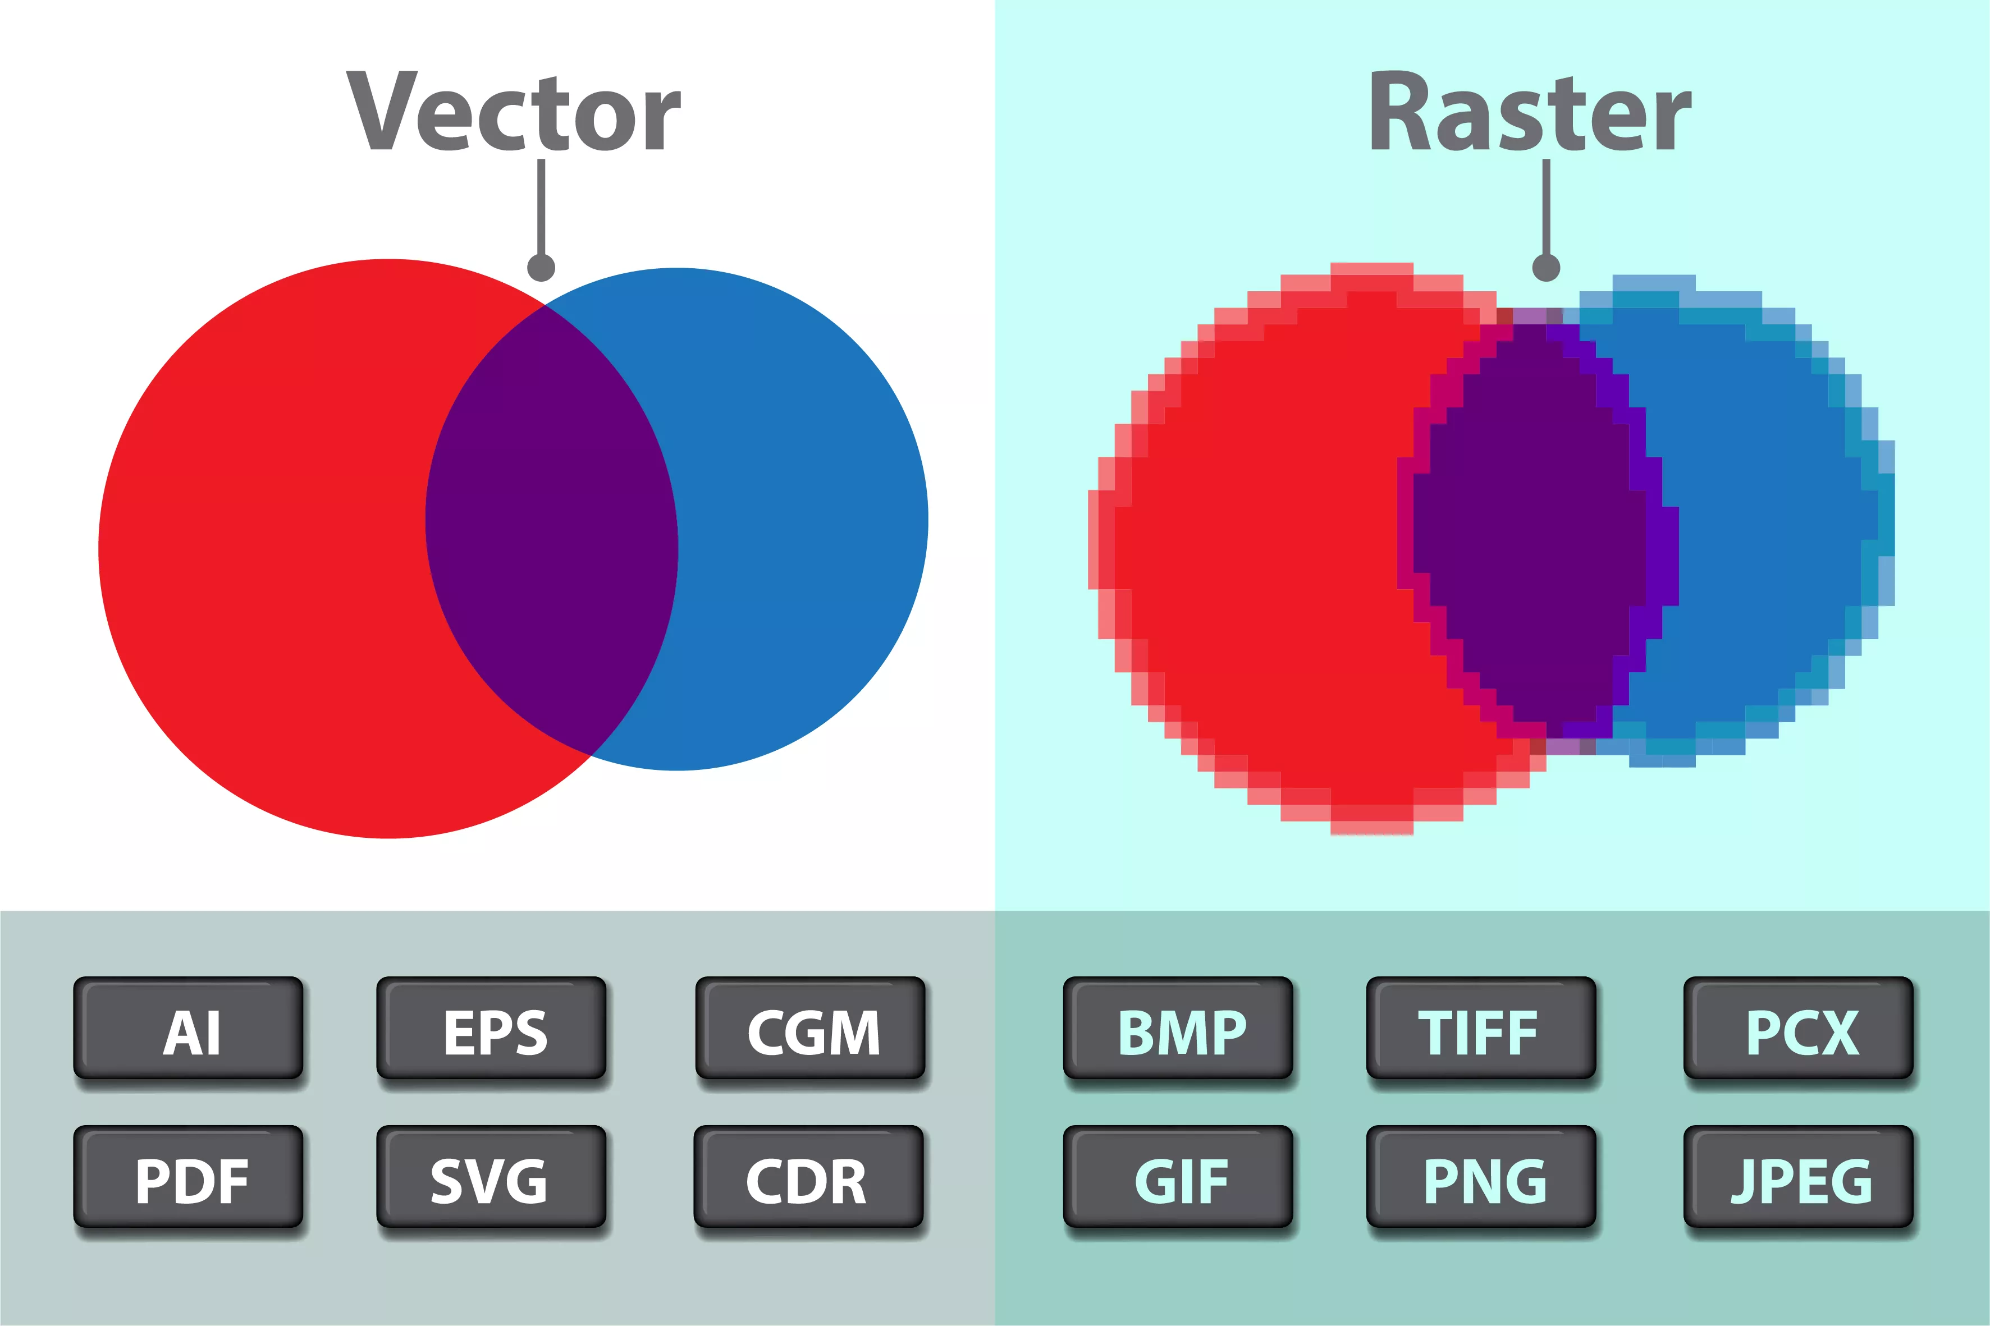
Number of bits per colored pixel
• 1 bit = 2 colors
• 4 bits = 16 colors
• 8 bits = 256 colors
• 16 bits = 65,536 colors
• 24 bits = 16,777,216 colors
• 32 bits = 4,294,967,296 colors

Slide 14
BMP VS RASTERIZED
Bitmap images store graphics information as grids of pixels, short for “picture elements.”
Raster images are also collections of pixels, but they store pixels in rows to make images easy to print.
In most cases, printing an image converts, or rasterizes, it to print pixels line by line instead of processing the complete collection of pixels.

Slide 15
Understanding Metafile Graphics
Metafile graphics combine raster and vector graphics and can have the characteristics of both file types.
For example, if you scan a photograph (a bitmap image) and then add text or arrows (vector drawings), you create a metafile graphic.

Slide 16
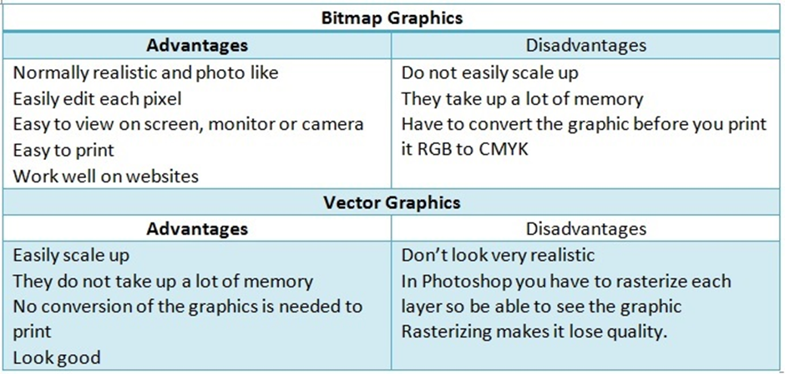

Slide 17
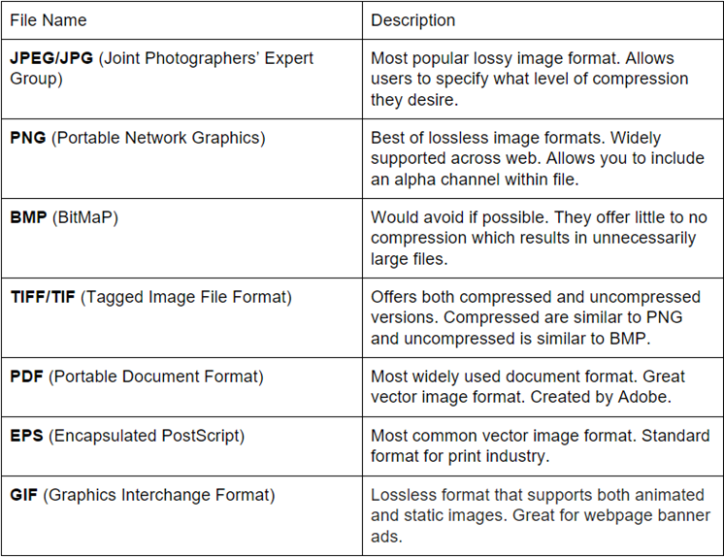

Slide 18
Understanding Digital Camera File Formats
Digital cameras’ popularity has had quite an impact on computer forensics because witnesses or suspects can create their own digital photos.
Examining the Raw File Format Referred to as a digital negative, the raw file format is typically used on many higher-end digital cameras.
The camera performs no enhancement processing—hence the term “raw” for this format.
Sensors in the digital camera simply record pixels on the camera’s memory card. The advantage of this format is that it maintains the best picture quality.

Slide 19
Examining the Exchangeable Image File Format
Most digital cameras use the Exchangeable Image File (EXIF) format to store digital pictures.
The Japanese Electronic Industry Development Association (JEIDA) developed it as a standard for storing metadata in JPEG and TIF files.
When a digital picture is taken, information about the camera, such as model, make, and serial number, and settings, such as shutter speed, focal length, resolution, date, and time, are stored in the graphics file. Most digital cameras store graphics files as EXIF JPEG files

Slide 20
Understanding Data Compression
Most graphics file formats, including GIF and JPEG, compress data to save disk space and reduce the file’s transmission time.
Other formats, such as BMP, rarely compress data or do so inefficiently.
In this case, you can use compression tools to compact data and reduce file size.
Data compression is the process of coding data from a larger form to a smaller form.

Slide 21
Lossless compression techniques reduce file size without removing data. When you uncompress a file that uses lossless compression, you restore all its information.
GIF and Portable Network Graphics (PNG) file formats reduce file size with lossless compression, which saves file space by using mathematical formulas to represent data in a file.
These formulas generally use one of two algorithms: Huffman or Lempel-Ziv-Welch (LZW) coding. Each algorithm uses a code to represent redundant bits of data.
Lossy compression is much different because it compresses data by permanently discarding bits of information in the file. Some discarded bits are redundant, but others are not.
In either case, the removed bits of information reduce image quality. The JPEG format is one that uses lossy compression.
Some popular lossless compression utilities include WinZip, PKZip, StuffIt, and FreeZip. Lzip is a lossy compression utility. You use compression tools to compact folders and files for data storage and transmission.

Slide 22
Module 5

Slide 23
Exploring the Role of E-mail in Investigations
You can send and receive e-mail in two environments: via the Internet or an intranet (an internal network).
In both e-mail environments, messages are distributed from a central server to many connected client computers, a configuration called a client/server architecture.
The server runs an e-mail server program, such as Microsoft Exchange Server, Novell GroupWise, or UNIX Sendmail, to provide e-mail services.
Client computers use e-mail programs (also called e-mail clients), such as Novell Evolution or Microsoft Outlook

Slide 24
Microsoft Exchange Server:
Microsoft Exchange Server: It is a widely used email server software created by Microsoft.
It provides email, calendar, and contact management functionalities and is commonly used by businesses to manage their email communication.
Microsoft Exchange Server can be deployed on-premises or in the cloud, and it integrates with other Microsoft applications such as SharePoint, Skype for Business, and Office 365.

Slide 25
Novell GroupWise:
It is an email and collaboration software created by Novell. It is designed to manage email, calendaring, instant messaging, task management, and document sharing.
GroupWise can be deployed on-premises or in the cloud, and it is known for its security and stability features.
It supports multiple platforms including Windows, Linux, and Mac OS.

Slide 26
UNIX Sendmail
It is a widely used email server software created for UNIX-based systems.
It is a basic email server that provides email transfer and delivery functionalities.
UNIX Sendmail is known for its simplicity and flexibility, and it can be customized to meet specific email requirements.
It is an open-source software and can be installed on various UNIX-based systems.

Slide 27
Regardless of the OS or e-mail program, users access their e-mail based on permissions the e-mail server administrator grants.
These permissions prevent users from accessing each other’s e-mail.
E-mail services on both the Internet and an intranet use a client/server architecture, but they differ in how client accounts are assigned, used, and managed and in how users access their e-mail.
Overall, an intranet e-mail system is for the private use of network users, and Internet e-mail systems are for public use.

Slide 28
In most cases, an intranet e-mail system is specific to a company, used only by its employees, and regulated by its business practices, which usually include strict security and acceptable use policies.
In an e-mail address, everything after the @ symbol represents the domain name.
You need to know the domain information when you investigate e-mail to identify the point of contact at the domain.

Slide 29
In contrast, a company that provides public e-mail services, such as Google, Hotmail, or Yahoo!, owns the e-mail server and accepts everyone who signs up for the service by providing a username and password.
E-mail companies also provide their own servers and administrators
In most cases, Internet e-mail users aren’t required to follow a standardized naming convention for usernames. They can choose their own usernames
For computer investigators, tracking intranet e-mail is easier because accounts use standard names the administrator establishes.
For example, jane.smith@mycompany.com is easily recognized as the e-mail address for an employee named Jane Smith

Slide 30
Investigating E-mail Crimes and Violations
Examining E-mail Messages
After you have determined that a crime has been committed involving e-mail, first access the victim’s computer to recover the evidence.
Using the victim’s e-mail client, find and copy any potential evidence. It might be necessary to log on to the e-mail service and access any protected or encrypted files or folders
The header contains unique identifying numbers, such as the IP address of the server that sent the message.

Slide 31
Recovering e mail
In some cases, you might have to recover e-mail after a suspect has deleted it and tried to hide it.
You see how to recover those messages in “Using AccessData FTK to Recover E-mail”
The email header is a code snippet in an HTML email, that contains information about the sender, recipient, email's route to get to the inbox and various authentication details.

Slide 32
The email header
The email header contains various fields of information about the email and its transmission. Some of the key components of an email header include:
From: The sender's email address and name (if included)
To: The recipient's email address and name (if included)
Date: The date and time that the email was sent
Subject: The subject line of the email
Received: A series of entries detailing the servers and networks that the email passed through to get to its destination
Message-ID: A unique identifier assigned to the email by the sending server
MIME-Version: The version of Multipurpose Internet Mail Extensions (MIME) used to format the email
Content-Type: The type of content included in the email, such as plain text or HTML

Slide 33
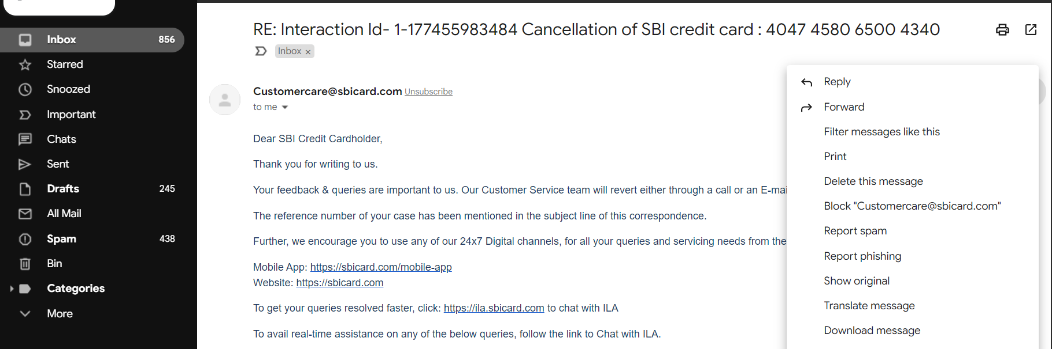


Slide 34
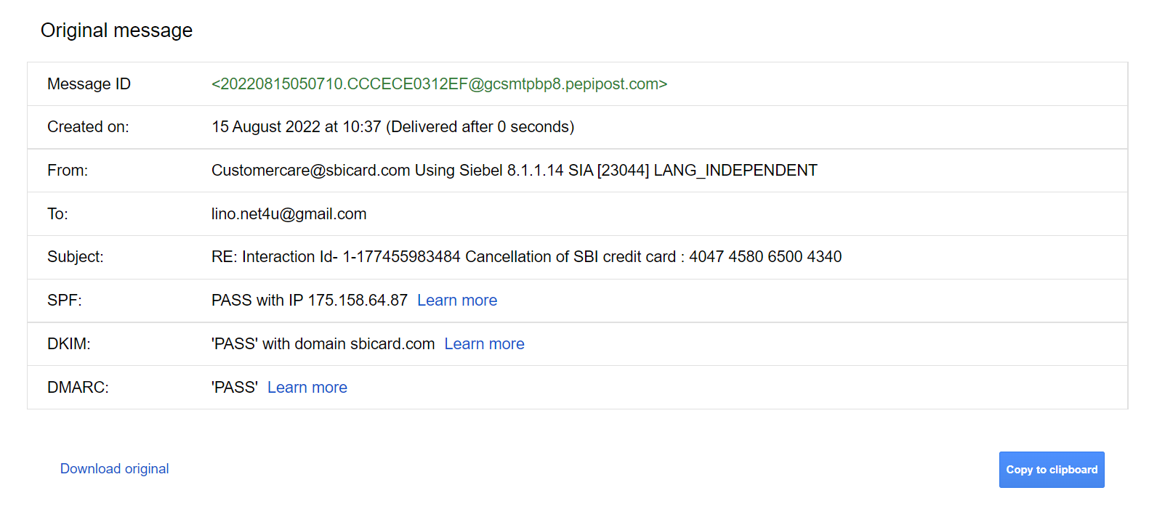

Slide 35
Microsoft Outlook is an email client that allows users to send, receive and manage emails, along with managing calendars, tasks, contacts and notes.
It is commonly used in business settings and is available as part of the Microsoft Office Suite.
Gmail, on the other hand, is a web-based email service provided by Google.
It allows users to access their email account through a web browser or through a mobile app.

Slide 36
One major difference between Microsoft Outlook and Gmail is their pricing model.
Microsoft Outlook is typically available as part of the Microsoft Office Suite, which requires a one-time purchase or a subscription fee. Gmail, on the other hand, is free to use but may require a subscription fee for additional storage space or features.
Another difference between the two is their user interface. Microsoft Outlook has a more traditional desktop application feel, while Gmail is more minimalist and browser-based.
Additionally, Microsoft Outlook is primarily designed for use in a corporate or enterprise setting, while Gmail is designed for personal and business use.

Slide 37
Copying an E-mail Message
Before you start an e-mail investigation, you need to copy and print the e-mail involved in the crime or policy violation.
You might also want to forward the message as an attachment to another e-mail address, depending on your organization’s guidelines.
The following activity shows you how to use Outlook, included with Microsoft Office, to copy an e-mail message to a USB drive.

Slide 38
Outlook copying
1. Insert a USB drive into a USB port.
2. Open Windows Explorer or the Computer window, navigate to the USB drive, and leave this window open.
3. Start Outlook by clicking Start, pointing to All Programs, pointing to Microsoft Office, and clicking Microsoft Office Outlook 2007.
4. In the Mail Folders pane, click the folder containing the message you want to copy. For example, click the Inbox folder.
A list of messages in that folder is displayed in the pane in the middle. Click the message you want to copy.
5. Resize the Outlook window so that you can see the message you want to copy and the USB drive icon in Windows Explorer or the Computer window.

Slide 39
To retrieve an Outlook e-mail header, follow these steps:
1. Start Outlook, and then select the original of the message you copied in the previous section.
2. Right-click the message and click Message Options to open the Message Options dialog box. The Internet headers text box at the bottom contains the message head
3. Select all the message header text, and then press Ctrl+C to copy it to the Clipboard.
4. Start Notepad, and then press Ctrl+V in a new document window to paste the message header text.

Slide 40
Tracing an E-mail Message
As part of the investigation, you need to determine an e-mail’s origin by further examining the header with one of many free Internet tools.
Determining message origin is referred to as “tracing.”
If the point of contact isn’t listed on the Web site or the domain doesn’t have a Web site, you need to use a registry site, such as those in the following list, to determine the point of contact:
• www.arin.net—Use the American Registry for Internet Numbers (ARIN) to map an IP address to a domain name and find the domain’s point of contact.
• www.internic.com—Like www.arin.net, you use this site to find a domain’s IP address and point of contact.
• www.freeality.com—This comprehensive Web site has options for searching for a suspect, including by e-mail addresses, phone numbers, and names.

Slide 41
Using Network E-mail Logs
Network administrators maintain logs of the inbound and outbound traffic routers handle.
Using these logs, you can determine the path a transmitted e-mail has taken.
The network administrator who manages routers can supply the log files you need.
Network administrators also maintain logs for firewalls that filter Internet traffic; these logs can help verify whether an e-mail message passed through the firewall.
Firewalls, such as WatchGuard, Cisco Pix, and Check Point, maintain log files that track Internet traffic destined for other networks or the network the firewall is protecting.

Slide 42
Understanding E-mail Servers
An e-mail server is loaded with software that uses e-mail protocols for its services and maintains logs you can examine and use in your investigation.
Your focus is not to learn how a particular e-mail server works but how to retrieve information about e-mails for an investigation.

Slide 43
Most e-mail administrators log system operations and message traffic to recover e-mails in case of a disaster, to make sure the firewall and e-mail filters are working correctly, and to enforce company policy.
However, the e-mail administrator can disable logging or use circular logging, which overwrites the log file when it reaches a specified size or at the end of a specified time frame.
Circular logging saves valuable server space, but you can’t recover a log after it’s overwritten
The only way to access the log file information is from a backup file, which many e-mail administrators create before a log file is overwritten.

Slide 44
e-mail logs generally identify
the e-mail messages an account received,
the IP address from which they were sent,
the time and date the e-mail server received them,
the time and date the client computer accessed the e-mail,
the e-mail contents,
system-specific information,
and any other information the e-mail administrator wants to track.

Slide 45
In addition to logging e-mail traffic, e-mail servers maintain copies of clients’ e-mail, even if the users have deleted messages from their inboxes.
Some e-mail servers don’t completely delete messages until the system is backed up.
Even if the suspect deletes the e-mail, sometimes the e-mail administrator can recover the e-mail without restoring the entire e-mail system.
. If you have a date and time stamp for an e-mail, the e-mail administrator should be able to recover it from backup media if the message is no longer on the e-mail server

Slide 46
Examining UNIX E-mail Server Logs
Sendmail e-mail server
Other UNIX e-mail servers produce similar log files in similar locations.
The files that provide helpful information are log files and configuration files.
Sendmail creates a number of files on the server to track and maintain the e-mail service.
The first one to check is /etc/sendmail.cf, which contains configuration information for Sendmail, so you can determine where log files are stored.
Sendmail refers to the sendmail.cf file to find out what to do with an e-mail after it’s received.
For example, if the server receives an e-mail from an unsolicited site, a line in the sendmail.cf file can tell the Sendmail server to discard it.

Slide 47
the syslogd file includes e-mail logging instructions.
By viewing this file, you can determine how Sendmail is set up to log e-mail events and which events are logged.
The syslogd file’s configuration is located in /etc/syslog.conf, which contains three pieces of information that tell you what happened to an e-mail when it was logged:
the event,
the priority level of concern,
and the action taken when it was logged.

Slide 48
The syslog.conf file simply specifies where to save different types of e-mail log files.
The first log file it configures is /var/log/maillog, which usually contains a record of Simple Mail Transfer Protocol (SMTP) communication between servers.
You can compare this information with the header of the e-mail the victim received to confirm the sender.

Slide 49
Examining Microsoft E-mail Server Logs Exchange Server, generally called Exchange, is the Microsoft e-mail server software.
Exchange uses a database and is based on the Microsoft Extensible Storage Engine (ESE), which uses several files in different combinations to provide e-mail service.
The files most useful to an investigation are
.edb and
.stm database files,
checkpoint files,
temporary files.

Slide 50
As a database server, Exchange logs information about changes to its data, also called transactions, in a transaction log.
To prevent loss of data from the most recent backup, a checkpoint file, or marker, is inserted in the transaction log to mark the last point at which the database was written to disk.
With these files, e-mail administrators can recover lost or deleted messages in the event of a disaster, such as a power failure.
Exchange servers can also maintain a log called Tracking.log that tracks messages
Except for special forensics tools, the message tracking log provides the most information about messages sent and received in Exchange.

Slide 51
Using Specialized E-mail Forensics Tools
For many e-mail investigations, you can rely on e-mail message files, e-mail headers, and e-mail server log files.
However, if you can’t find an e-mail administrator willing to help with the investigation, or you encounter a highly customized e-mail environment, you can use data recovery tools and forensics tools designed to recover e-mail files.
As technology has progressed in e-mail and other services, so have the tools for recovering information lost or deleted from a hard drive.

Slide 52
Third-party tool
When you use a third-party tool to search for a .db file, for example, you can find where the administrator stores .db files for the e-mail server. To find log files, use .log as the search criteria.
You’re likely to find at least two logs related to e-mail—one listing logged events for messages and the other listing logged events for accounts accessing e-mail.
FTK, EnCase, and other forensics tools enable you to find e-mail database files, personal e-mail files, offline storage files, and log files.
Some tools allow you to view messages and other files with a special viewer; others require using a text editor to compare information, such as the date and time stamp, username, domain, and message contents, to determine whether it matches what was found on the victim’s computer.

Slide 53
Using a Hexadecimal Editor
acquiring Evolution e-mail directories and extracting messages with Hex Workshop.
These techniques can be used with all e-mail systems that create flat plaintext files, known as an mbox format, to store messages.
Vendor-unique e-mail file systems, such as Microsoft .pst or .ost, typically use Multipurpose Internet Mail Extensions (MIME) formatting, which can be difficult to read with a text or hexadecimal editor.

Slide 54
e-mail messages from Evolution
Evolution is the official personal information manager and mail client for the GNOME Desktop Environment.
It is Free and Open Source Software, licensed under the GPL.
To carve e-mail messages from Evolution, you need to copy the .evolution directory, its subdirectories, and content to another storage medium that can be transported to your forensic workstation.
One way is to export the .evolution directory and subdirectories from an image file to a target directory by using a forensics tool, such as FTK, EnCase, X-Ways Forensics, or Sleuth Kit and Autopsy.
These tools export the directory with all subdirectories to the target drive path you designate.

Slide 55
Case study
.evolution directory from Martha Dax’s Linux computer to see whether you can find the same e-mail you found in the Jim_shu’s.pst file. Then you compare the message headers of the two e-mails to detect any differences.
1. Log on to your Linux computer and open a command shell. Type su and press Enter, and then type the password for root and press Enter
2. Connect a USB drive to your computer and mount it. 3. Navigate to the user’s home directory. For this example, you would type cd /home/martha and press Enter
4. Type tar cf martha-evolution.tar .evolution and press Enter.
5. Using File Manager or another GUI directory utility, copy martha-evolution.tar to a USB drive, and then unmount and remove it.
6. Type exit and press Enter, and then log off your Linux computer.

Slide 56
Understanding the Importance of Reports
You write a report to communicate the results of your forensic examination of a computer or network system. A forensics report presents evidence in court, at an administrative hearing, or as an affidavit used to support issuing an arrest or a search warrant.
All reports to the client should start by stating this mission or goal, which is usually to find information on a specific subject, recover certain important documents, or recover certain types of files or files with specific dates and times.
Clearly defining the goals reduces the time and cost of the examination and is especially important with the increasing size of hard drives and networks

Slide 57
Types of Reports
Computer forensics examiners are required to create different types of reports, such as a formal report consisting of facts from your findings, a preliminary written or verbal report to your attorney, and an examination plan for the attorney who has retained you
An examination plan is a document that serves as a guideline for knowing what questions to expect when you’re testifying

Slide 58
A verbal report
A verbal report is usually a preliminary report and addresses areas of investigation yet to be completed, such as the following:
• Tests that haven’t been concluded
• Interrogatories that the lawyer might want to address to opposing parties
• Document production, either requests for production (to parties) or subpoenas (to non-parties, people who have information but aren’t a named party in the case)
• Determining who should be deposed and the plan for deposing them

